Slide 1
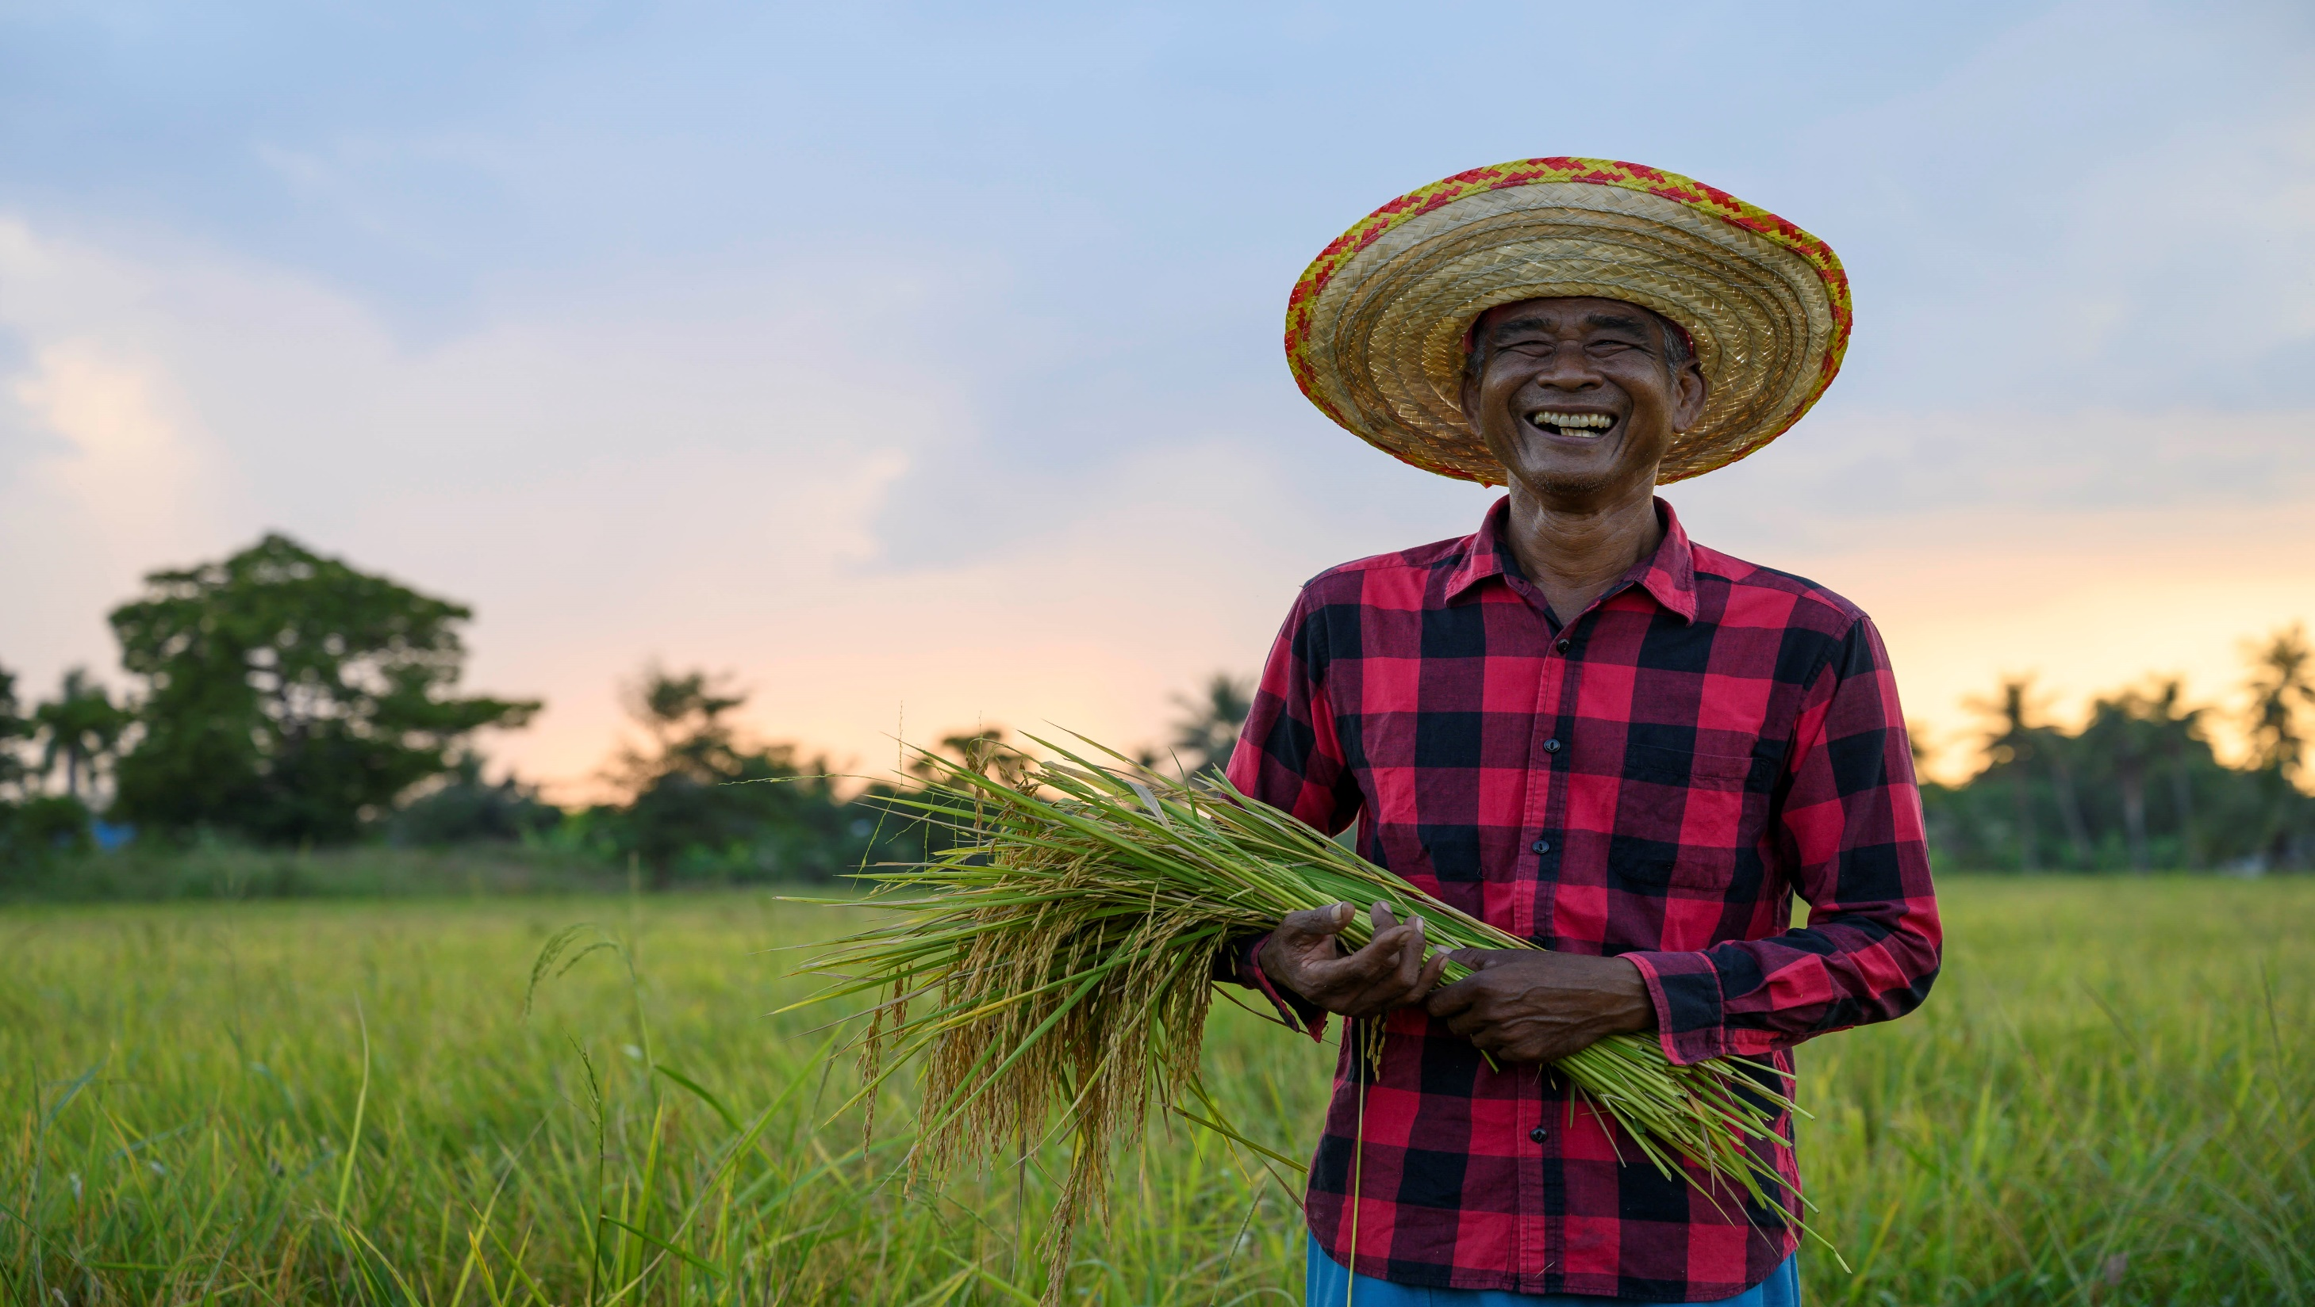





#buildwithai

Slide 2
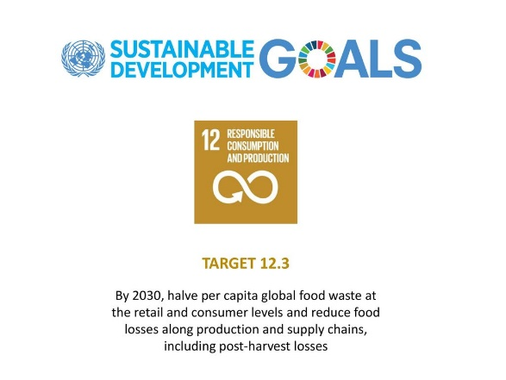

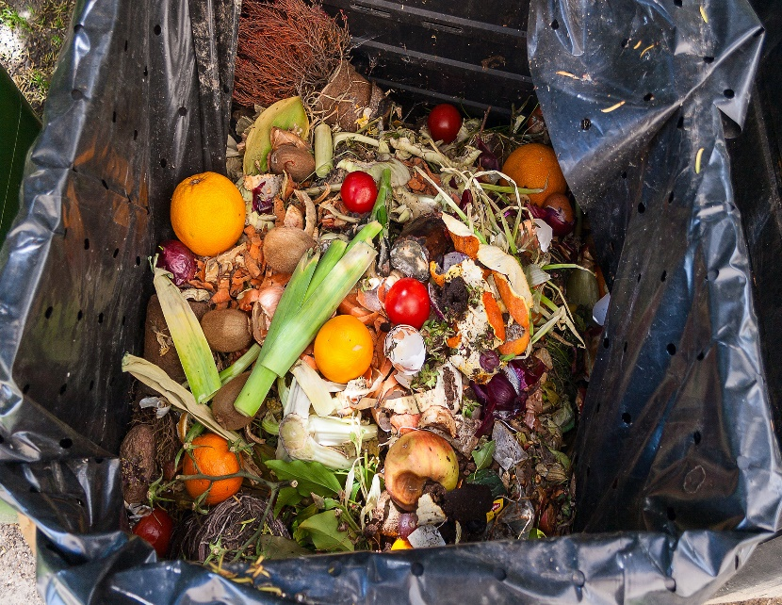





GLOBAL CONTEXT
.
Sustainable Development Goal (SDG) target 12.3, which aims at halving per capita global food waste at the retail and consumer levels and reducing food losses along production and supply chains, including postharvest losses.
Lack of access to valuable data presents a challenge to the food ecosystem and supply chain, with AI can improve yield, reduce waste and ensure zero hunger.
1/3 of worlds food is lost each year due to various sources of wastage
World Hunger
R 800 million globally
(suffer from hunger)
R 2 billion children
(micro deficiency )
9 billion people , by 2050 to feed
45%
Fruits & Vegetables
30-
60%
Less yields
(due to stress and supply chain inefficiency )
Innovative solutions need to be implemented and technology and information sharing can help produce enough food and correctly distribute it around the planet
Notes:
n Sustainable Development Goal (SDG) target 12.3, which aims at halving per capita global food waste at the retail and consumer levels and reducing food los ses along production and supply chains, including postharvest losses.
https://www.worldhunger.org/world-child-hunger-facts/

Slide 3
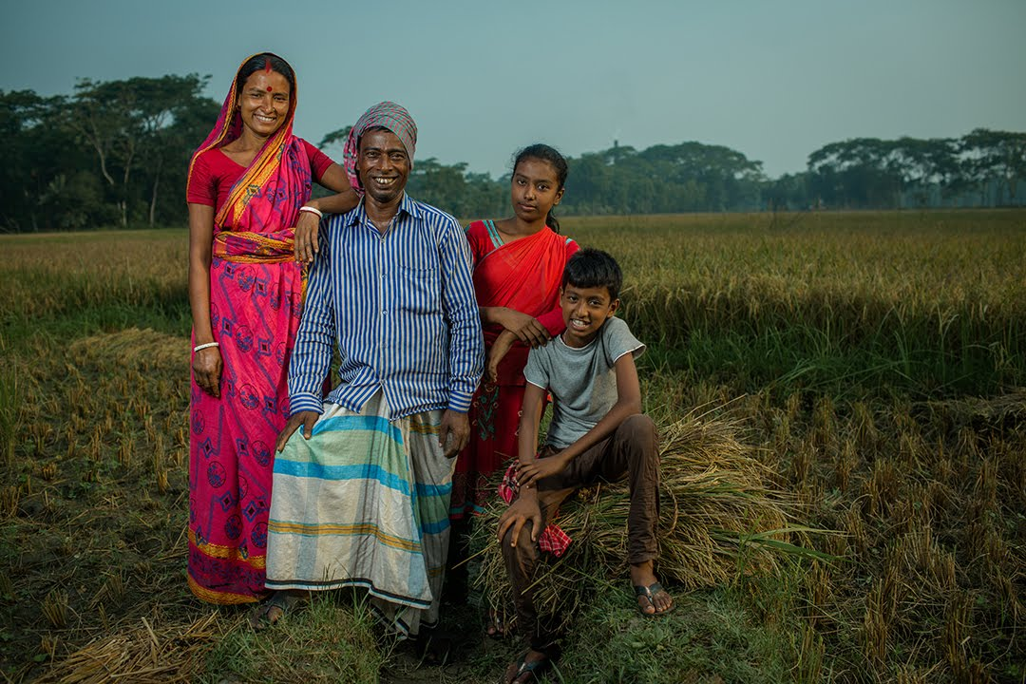
STORY
On November 2019 we went on a campaign in Bangladesh organized by BRAC NGO supporting the idea ‘ A Farmers Journey to Save His Family From Hunger’. This is Siraj - he is a local farmer in Bangladesh , he loses 30 % of his crops due to climate change , lack of information. He wanted a way if we could save his family from hunger and feed his family with 3 nutrition meals a day.

Slide 4
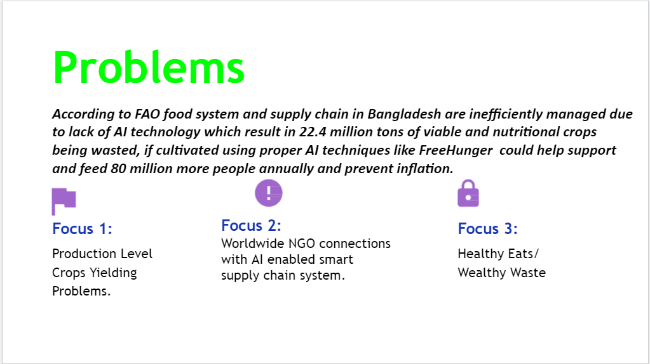

Slide 5
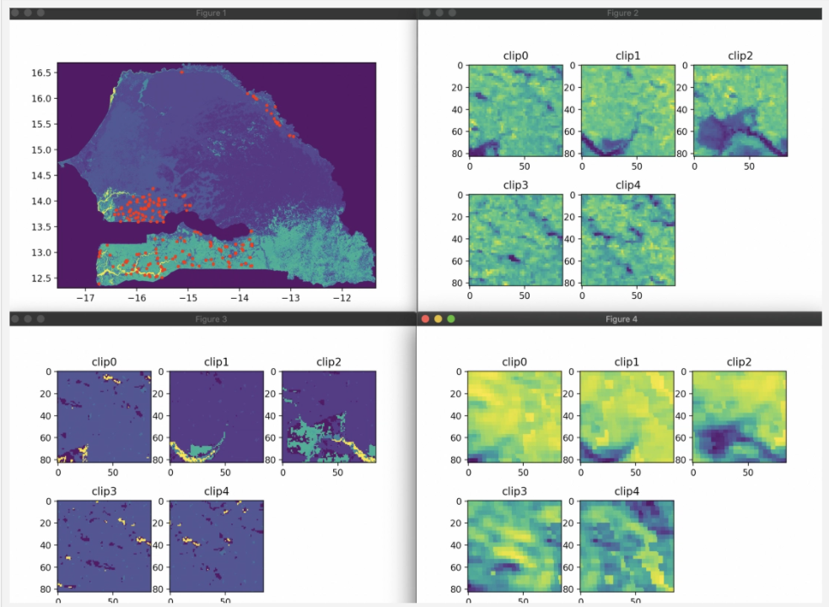




Key Concepts
OUR SOLUTION
FreeHunger is an affordable solution to provide farmers and NGOs with a complete set of necessary agricultural and food system data
Efficient
Simple
Cheap
Production Level:
Weekly Satellite Data monitoring for crops yielding identifying specific farming land along with crops stress monitoring.
Connecting the World
AI-enabled supply chain process to visualize NGO data relating to food system, to enable them to ensure constant, nutritional and reliable food provision to prevent hunger shortages
Nutrition and Waste Control Image Processing and object detection to identify good and healthy food(OCR verifications for cooked/packed food) and maintain a nutritious diet. Also wealth waste is the smart way to recycle food items.

Slide 6
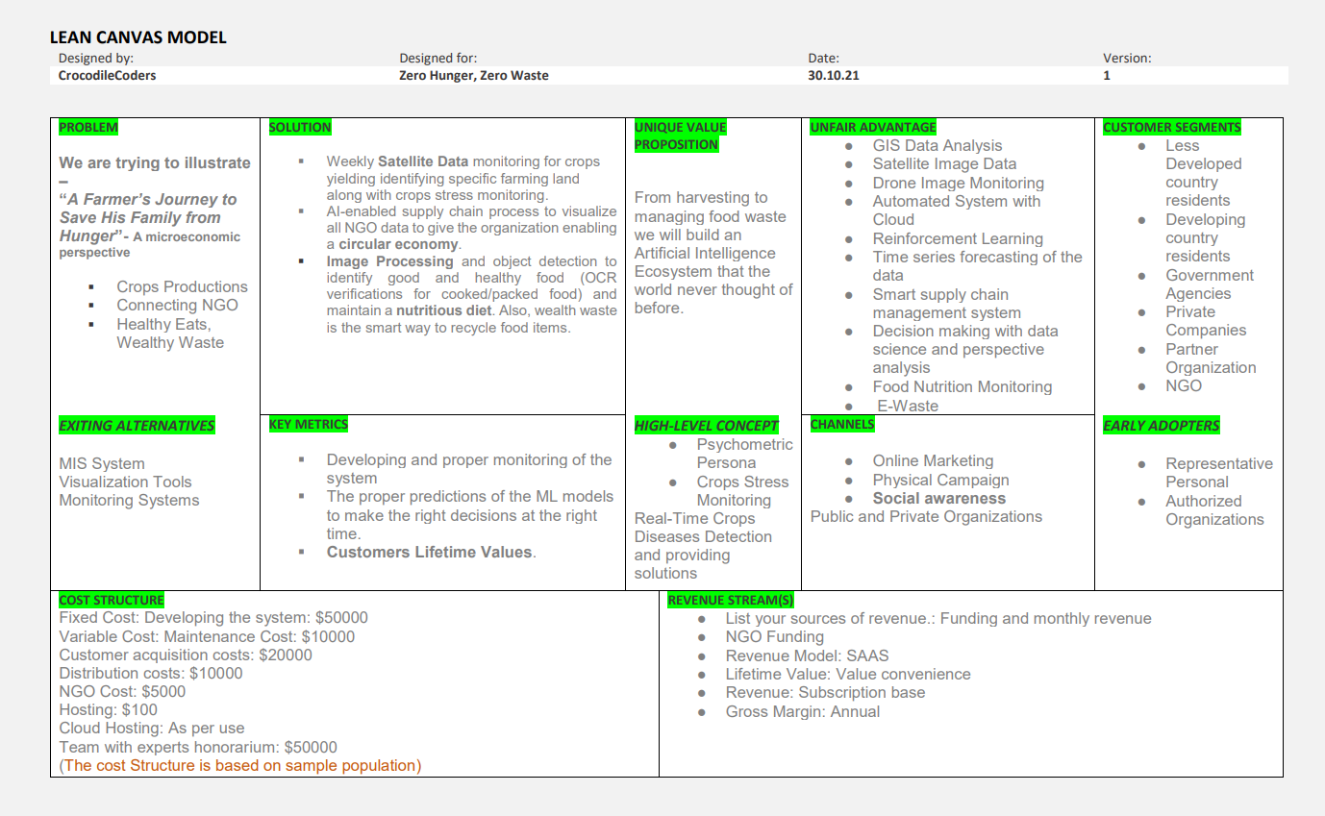

Slide 7
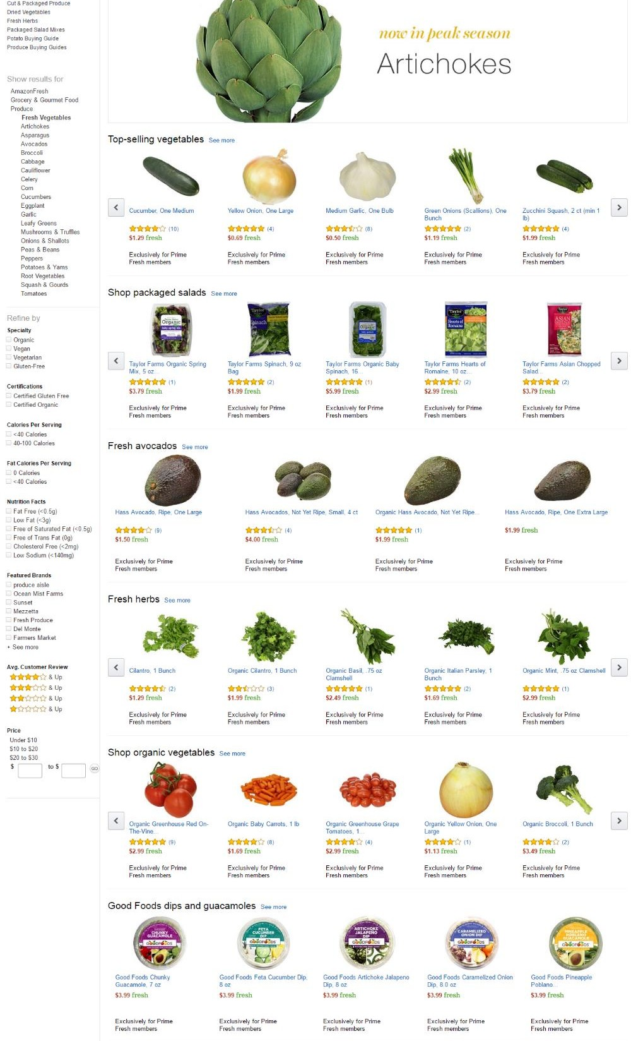




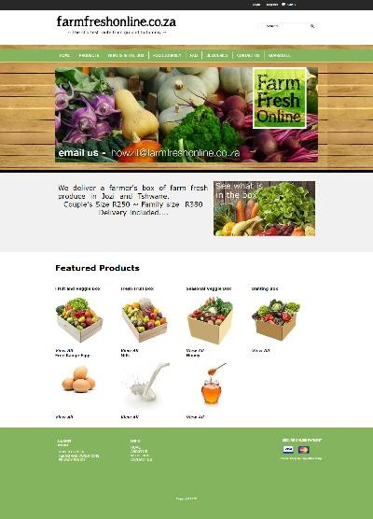

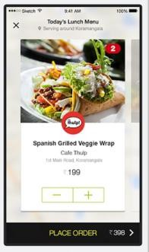

OUR SOLUTION
•
•
•
•
•
•

Slide 8
System Level:
SYSTEM COMPONENT
Production Level | Connecting NGO | Zero Hunger , Waste Control | Business model
GIS Data Set Analysis Know Your Need - -Supply Demand Analysis Crops Stress Monitoring | Supply Chain Ecosystem of The NGO Embedding circular economy | Food Image Classification Nutrition Monitoring of the food item Recycling the food Proper Decision Taking through AI | Lean Canvas Customer Segmentation Cost and Revenue

Slide 9
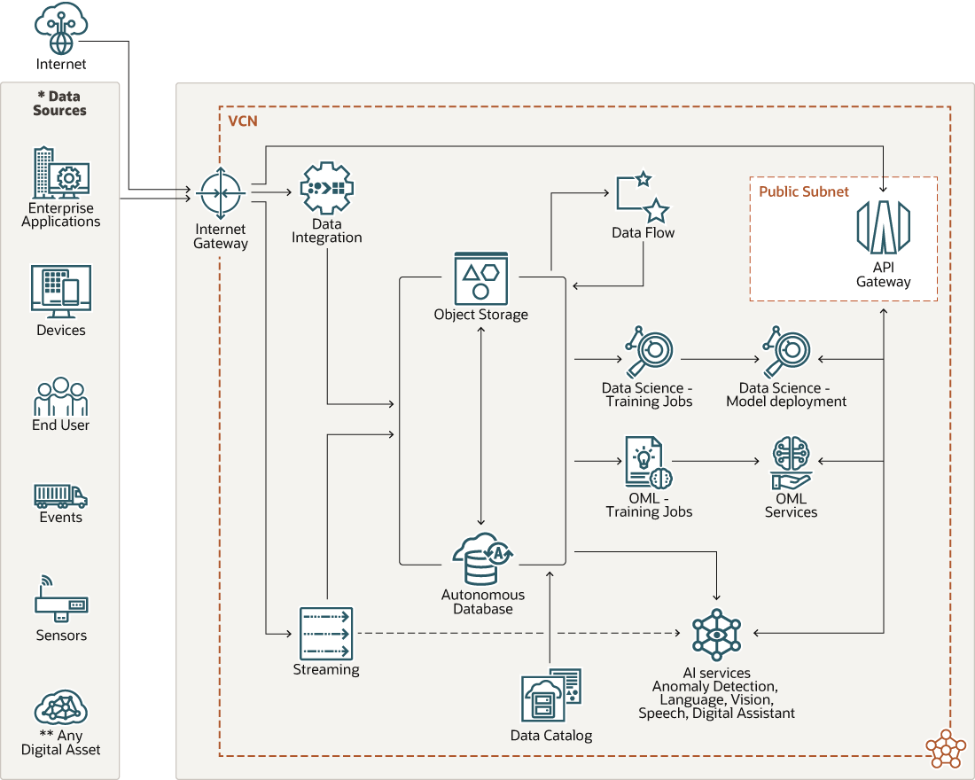

Slide 10

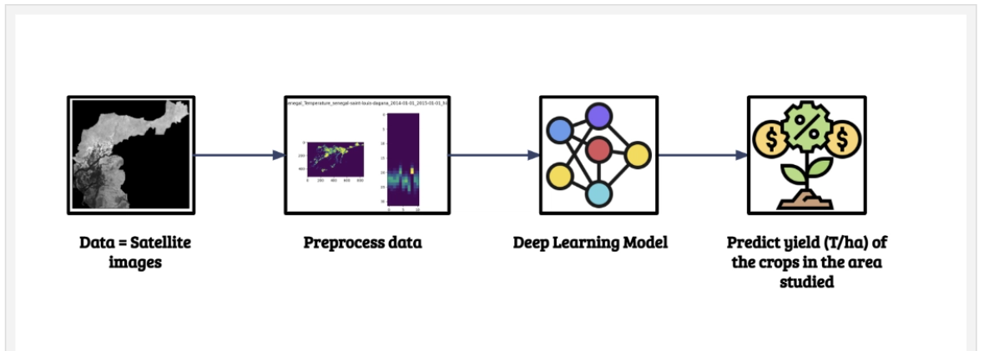
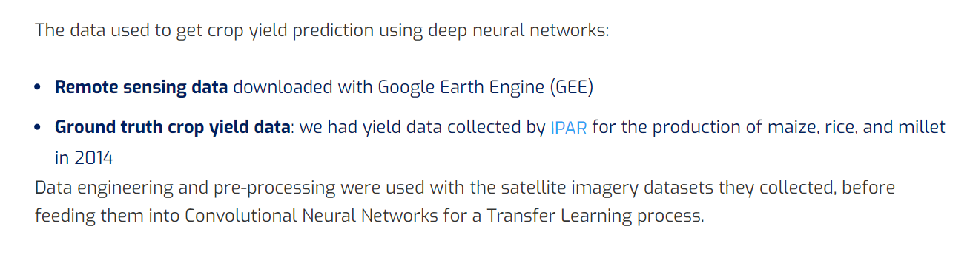
GIS MAPPING

Slide 11
SMART SUPPLY CHAIN

Slide 12
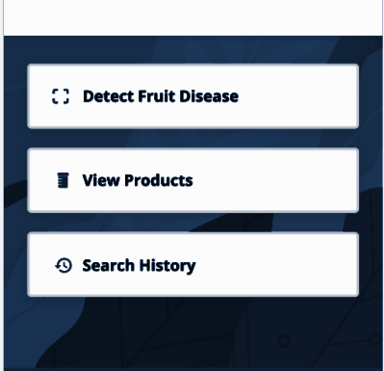
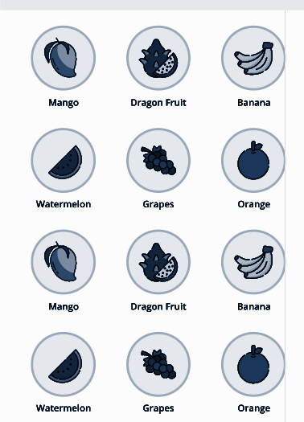
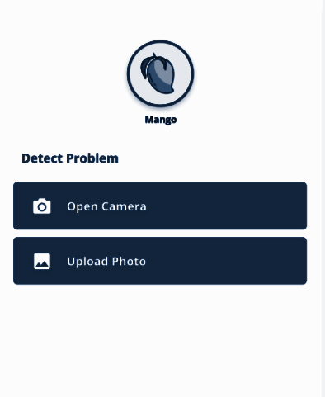
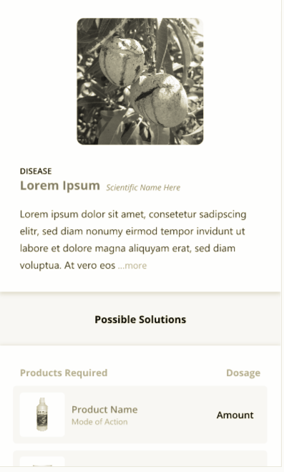
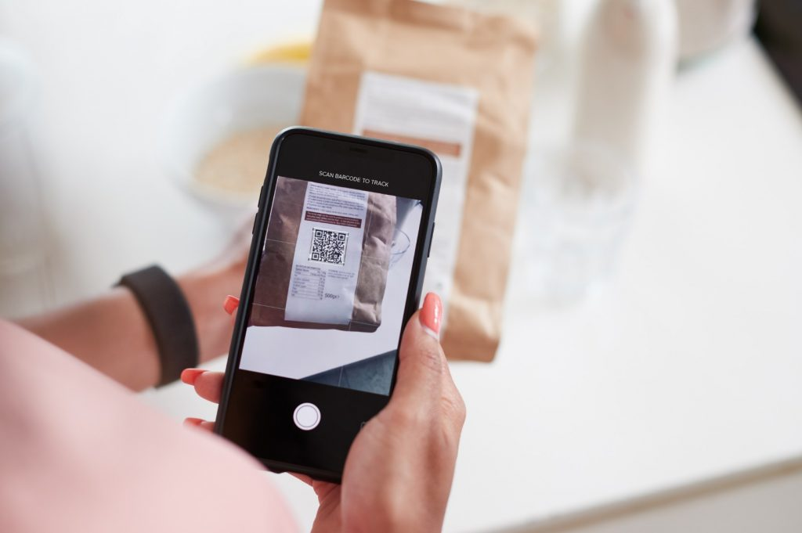
Food Diseases and Nutrition Observation

Slide 13
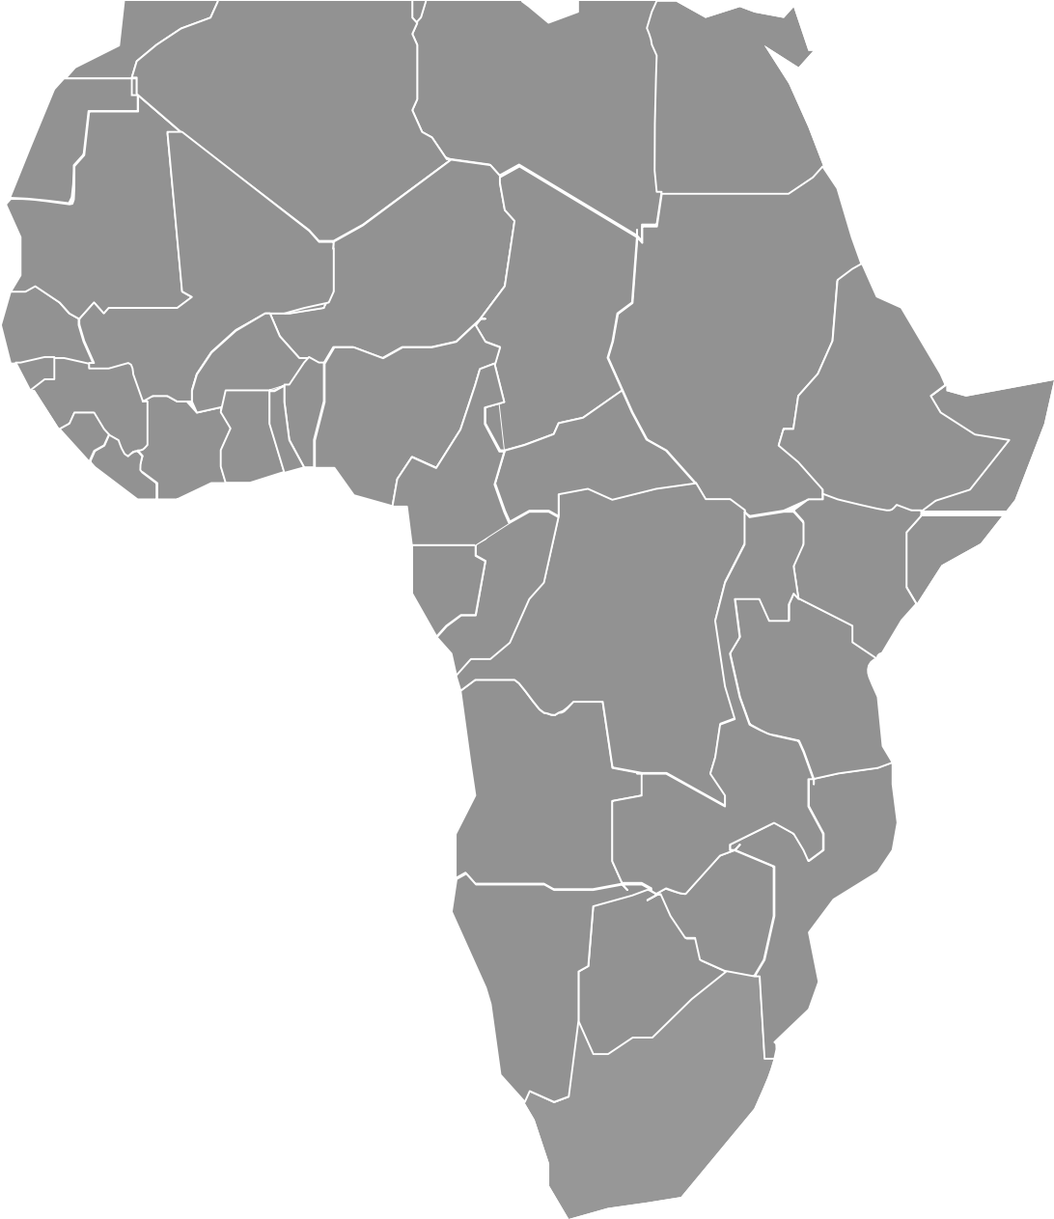












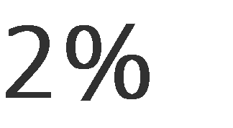
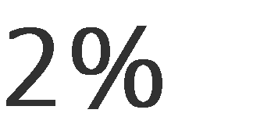






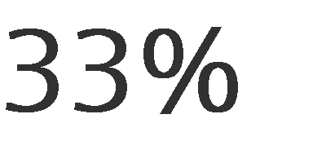
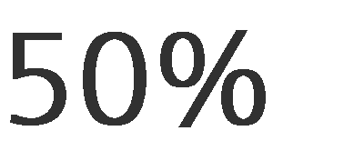
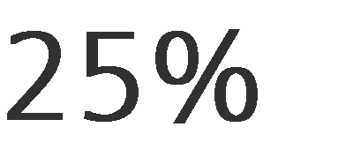







Slide 14
BUSINESS MODEL
How we plan to make money.
Customers:
Under Developed country residents
Developing country residents
Government Agencies
Private Companies
Partner Organization
NGO
Positions:
Online Marketing
Physical Campaign
Social awareness
Public and Private Organizations
Revenue:
NGO Funding
Revenue Model: SAAS
Lifetime Value: Value convenience
Revenue: Subscription base
Gross Margin: Annual

Slide 15
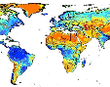
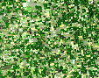
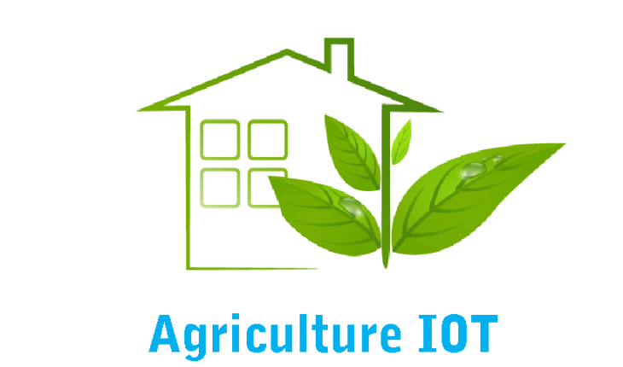
Step 1
BuildwithAI Support
The Next Technology in Food Production
MILESTONES
Agriculture Simulation
Simulations leverage real-time data to mirror the physical world in a virtual model
Big Data and Analytics
Step 2
Making the MVP
Analytics based on large datasets to optimise production quality, save energy, and improve equipment service
Step 3
Developing the Ecosystem
Industrial IoT
Internet of Things or new devices enriched with embedded computing (e.g. Cloud storage, cyber security, etc.)
Step 4
Scalability of the system

Slide 16

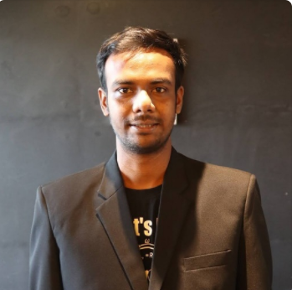
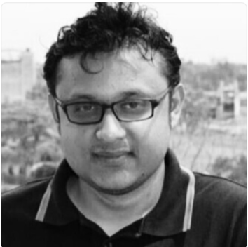
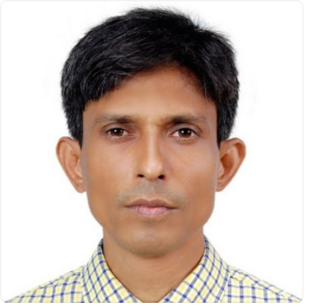
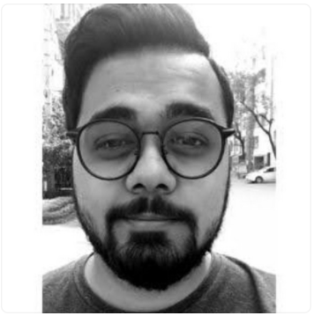
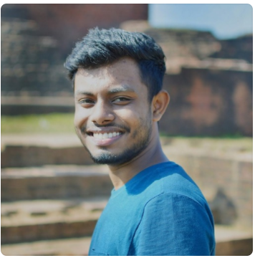
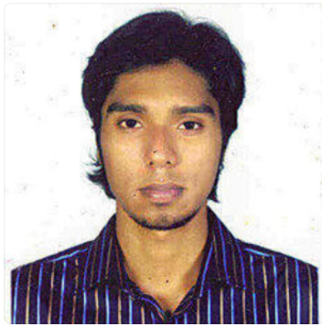
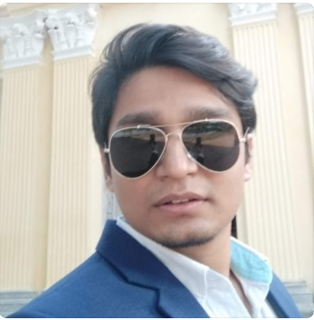
OUR CROCODILECODERS
TAREQ
RIAD
RAJIB
Officer
ABIR
HASIDUL
SARIF
Shad

